Slide 1
Double Beta Decay in Xenon-136:
Measuring the Neutrino-Emitting Mode and Searching for Majoron-Emitting Modes
Steven Herrin
Ph.D. Dissertation Defense
2013-05-24

Slide 2
Outline
Neutrino physics and double beta decay
The EXO-200 detector
  Liquid xenon
  Design and construction
  Data collection
  Calibration
Cosmic ray muons
Double beta decay
  Statistics
  Measurements!
The future

Slide 3
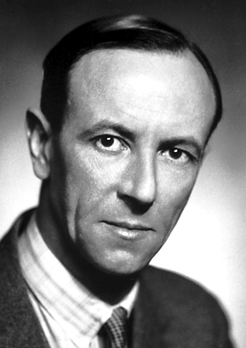
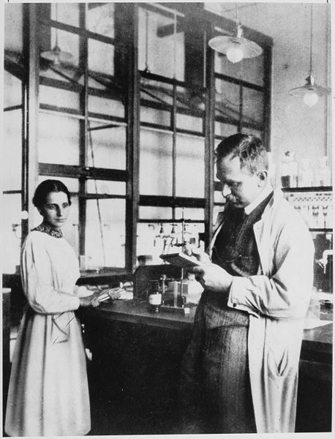
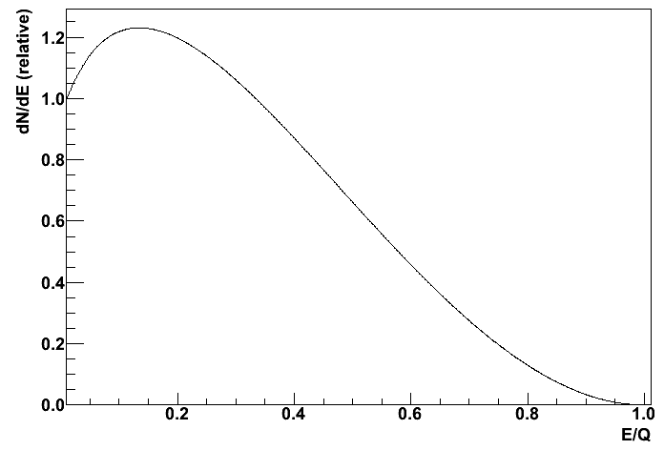
Neutrino Physics Starts with Beta Decay
Where is the rest of the energy going?
electron
N neutrons
Z protons
N-1 neutrons
Z+1 protons
?
(electron energy)/(maximum energy)
James Chadwick
Lise
Meitner
Otto
Hahn

Slide 4
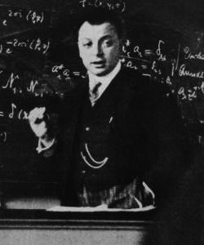
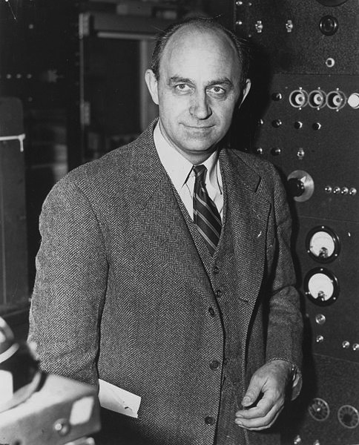
Neutrino Physics Starts with Beta Decay
electron
(anti)neutrino
electron
neutrino
neutron
proton
N neutrons
Z protons
N-1 neutrons
Z+1 protons
ν
(electron energy)/(maximum energy)
Wolfgang Pauli
Enrico Fermi

Slide 5
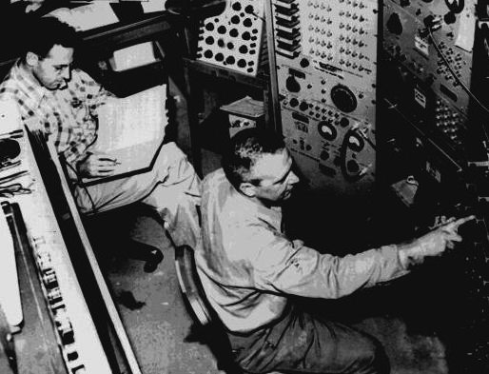
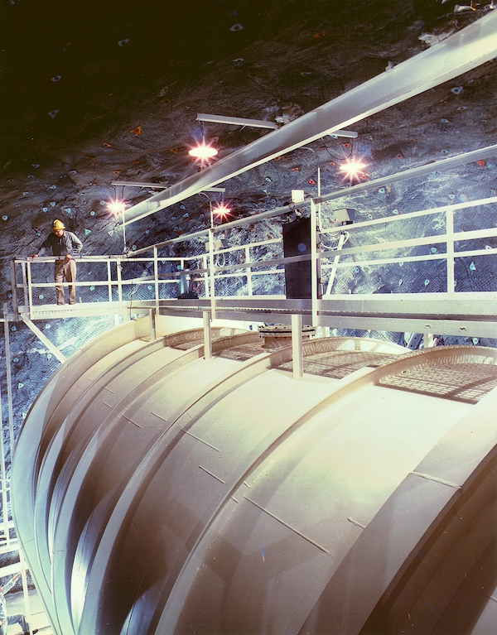
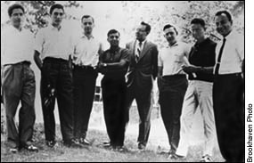
Half a Century of Neutrino Physics
Frederick
Reines
Clyde
Cowan
“inverse beta decay”
“solar neutrino problem”
Nuclear Reactor
Beginning late 1960s:
Measure only ~1/3 of the neutrinos expected from fusion in the sun
antineutrino
proton
positron
neutron
1953: Confirm existence of (anti)neutrino
J. Steinberger
K. Goulianos
J. Galliard
N. Mistry
G. Danby
W. Hayes
L. Lederman
M. Schwartz
muon
(never electron)
muon
neutrino
Ar
π
Cl
1963: Muon neutrino ≠ Electron neutrino
Raymond Davis, Jr.
John Bahcall
Homestake Experiment

Slide 6
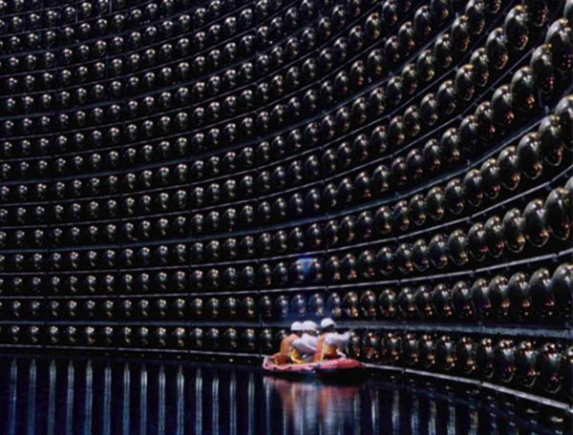
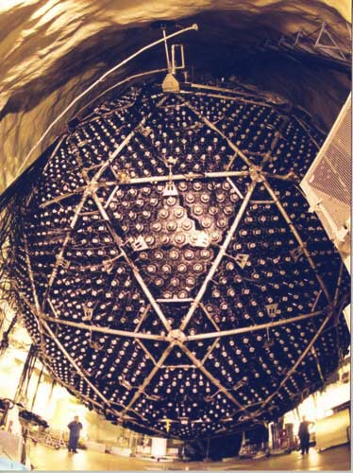
Neutrino Oscillations
SuperK (1998): Neutrinos produced in the upper atmosphere oscillate
SNO (2001): Neutrinos produced in the sun oscillate
The neutrino flavor states that participate in weak interactions (like beta decay) are not the mass states that propagate!
muon
electron!
For only 2 flavors:
neutrino
L

Slide 7
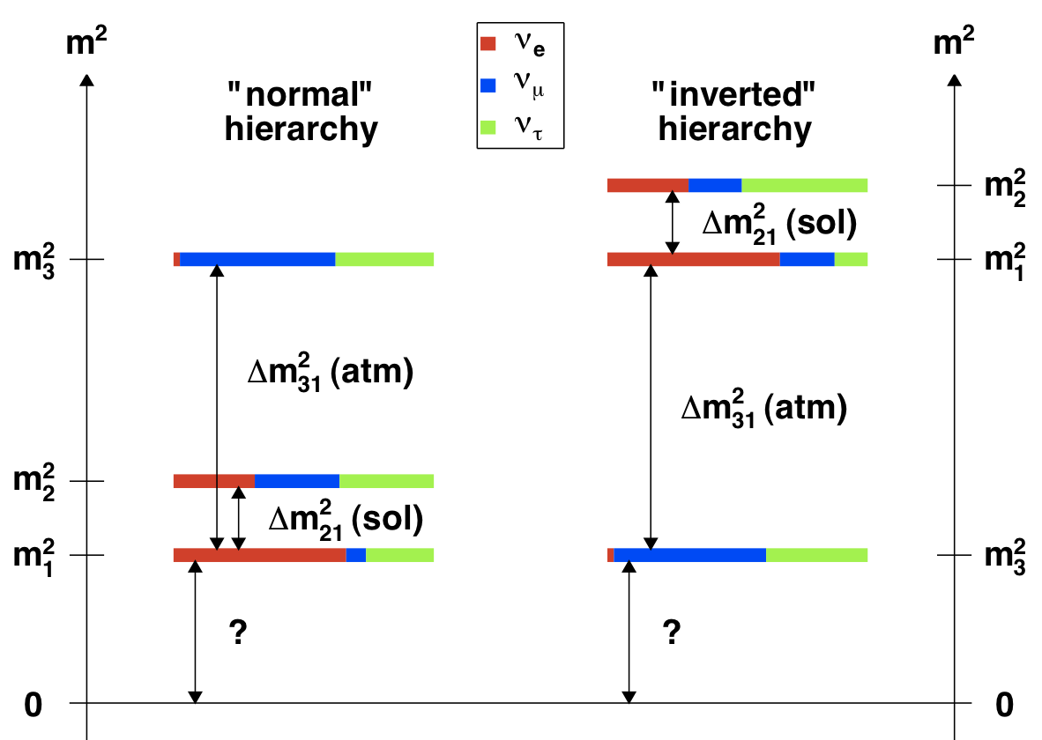
Neutrino Knowledge Summarized
LEP (Z width): 3 (light) neutrinos
“PMNS Matrix”
Compare to muon-electron mass splitting
[Produced with values from Forero et al. (2012) arXiv:1205.4018]

Slide 8
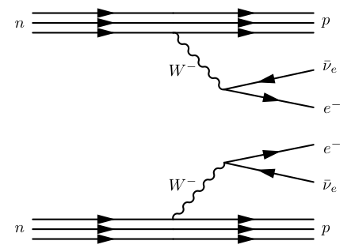
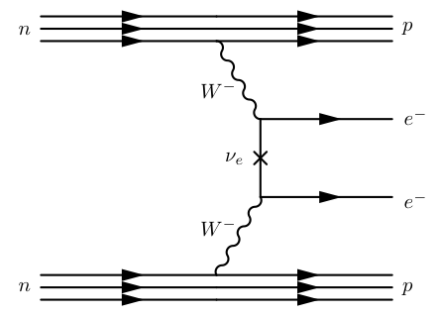
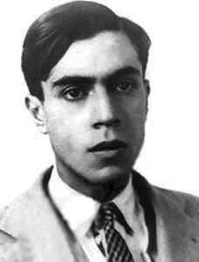
Double Beta Decay
2 electrons
2 neutrinos
2 electrons
N neutrons
Z protons
N-2 neutrons
Z+2 protons
N neutrons
Z protons
N-2 neutrons
Z+2 protons
neutrino is its own antiparticle
“Majorona”

Slide 9
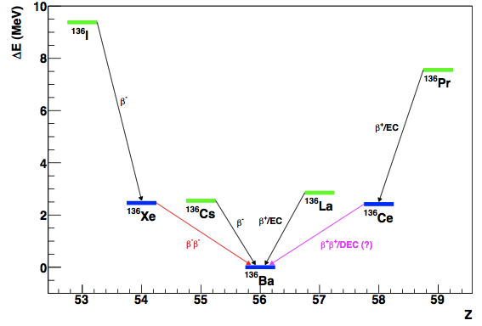
Double Beta Decay: Why Care?
Phase space factor
(this is known)
Nuclear Matrix Element
(can be modeled)
The standard mode has been observed.
Measured
Nuclear Matrix Element
(evaluate models)
[NEMO-3, (2005) PRL 95]
[EXO-200, (2012) PRL 107]

Slide 10
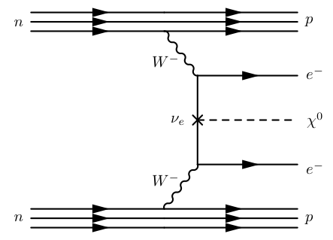
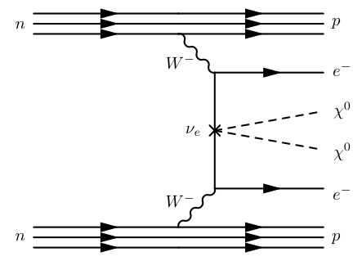
Double Beta Decay: While You're At It
Coupling Constant
Number Emitted
Many models predict Majorons:
Goldstone boson resulting from breaking of lepton symmetry
or something that carries lepton number to conserve that symmetry
“Majorons”

Slide 11
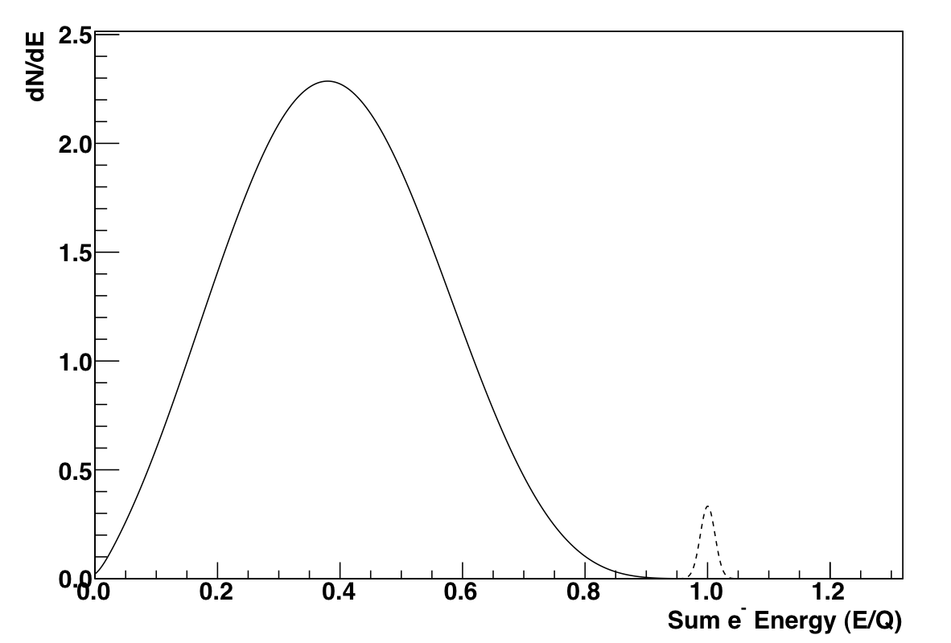
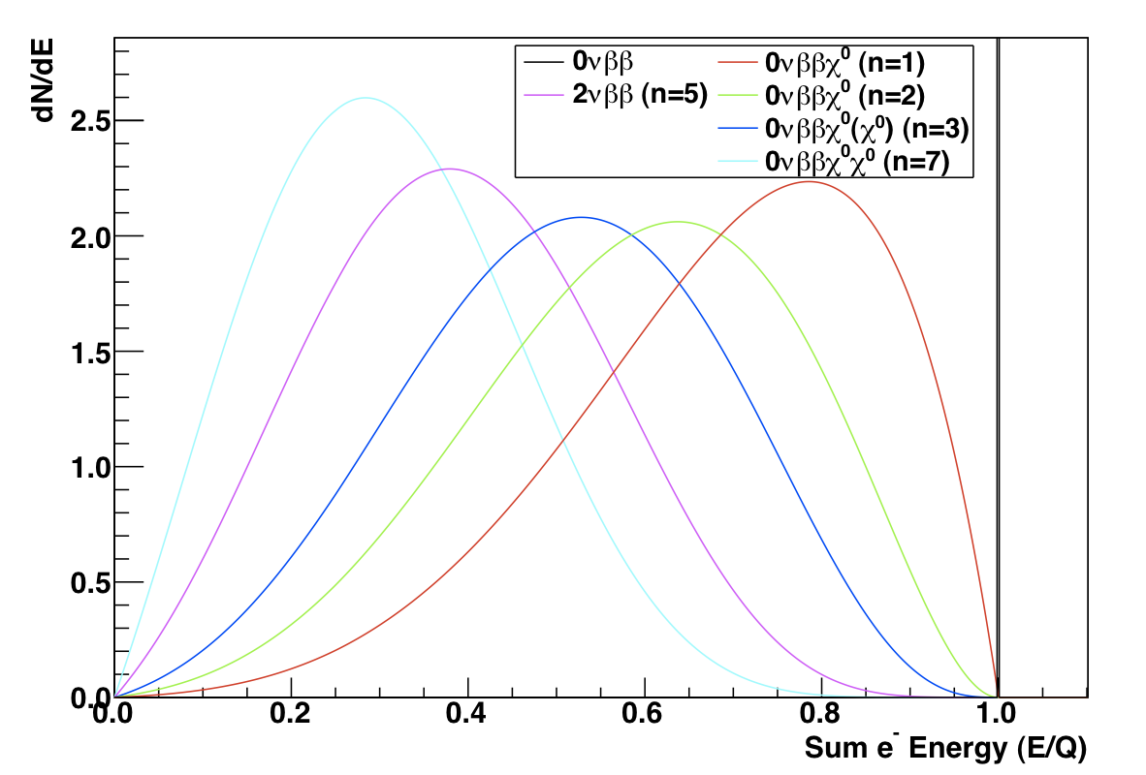
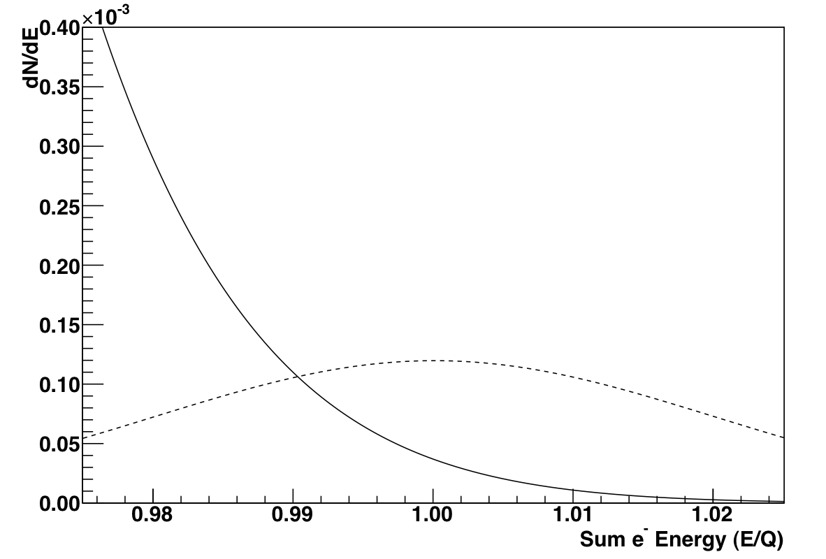
Searching for Double Beta Decay
Majoron-emitting modes have different shape
Sensitive Detector:
lots of atoms M/m
isotopic enrichment a
low background b
good energy resolution Γ
good efficiency ε

Slide 12
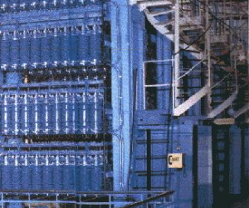
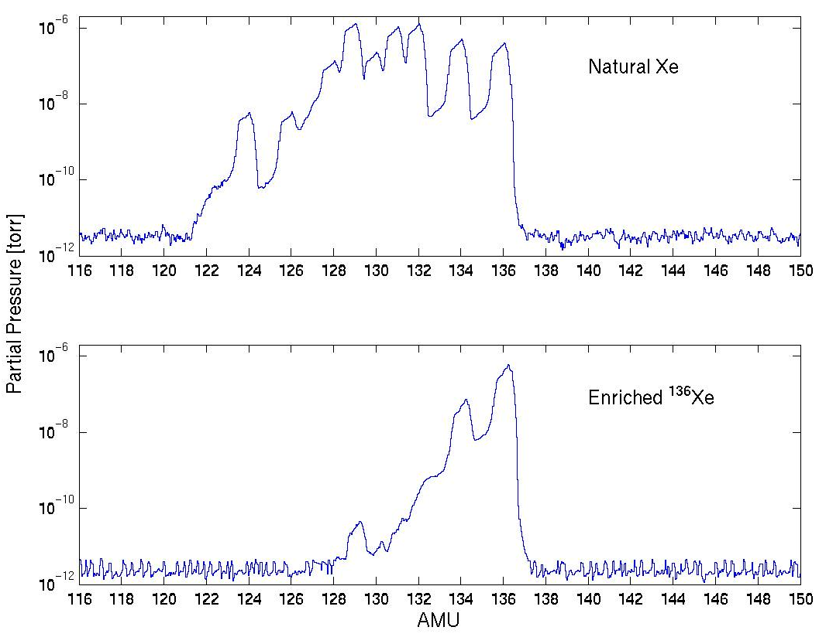
EXO-200 for Double Beta Decay
scintillation
(175 nm)
Drift Field
ionization
e-
200 kg of enriched xenon
(80.6% xenon-136)
Cathode
(-8 kV)
APDs
U wires
V wires
Liquid xenon Time Projection Chamber (TPC):
radiation deposits energy in the liquid xenon
forms scintillation light (collected by APDs)
form ionization (drifted by electric field to wires)
crossed wires and timing give event position
Monolithic: xenon is both the detector and the source

Slide 13
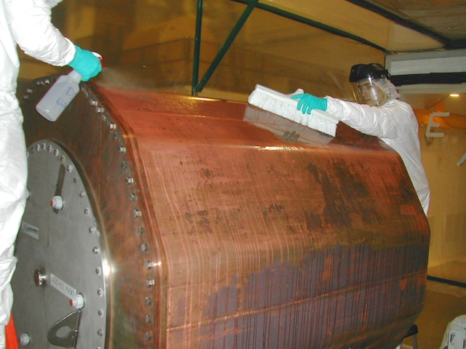
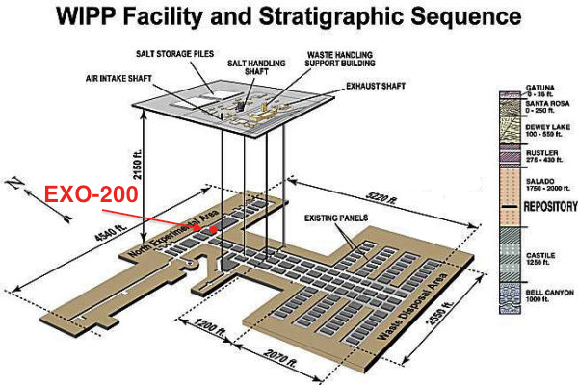
Reducing Backgrounds
Extensive material screening and cleaning
γ ray
γ ray
[D.S. Leonard et al. Nucl. Instr. Meth. A 591 (2008)]
ββ decay
“Multiple Site” events
“Single Site” events
γ
β
α particles have a higher scintillation-to-ionization ratio
655 m
²¹⁴Bi
α
²¹⁴Po
²¹⁰Pb
Underground to reduce cosmic ray backgrounds
half life
164 µs
timing

Slide 14
Experiments are Complimentary

